Slide 1
Quiz

Slide 2
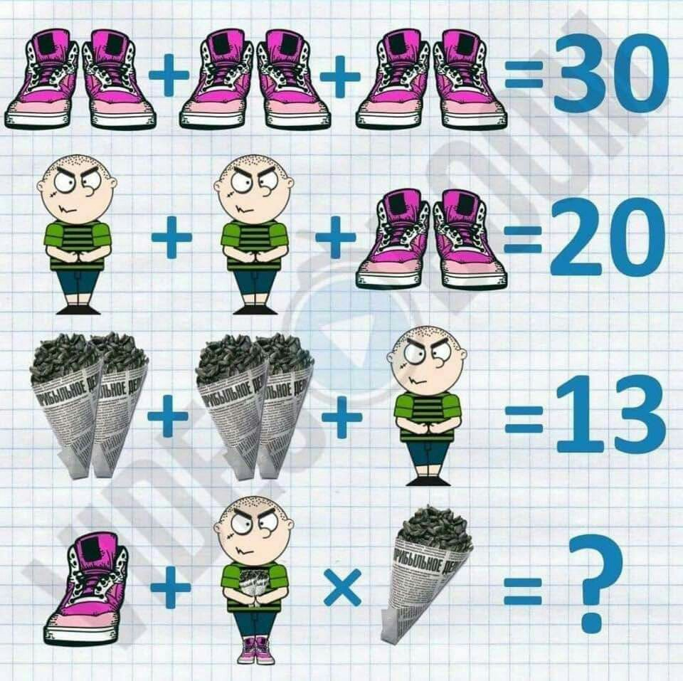

Slide 3
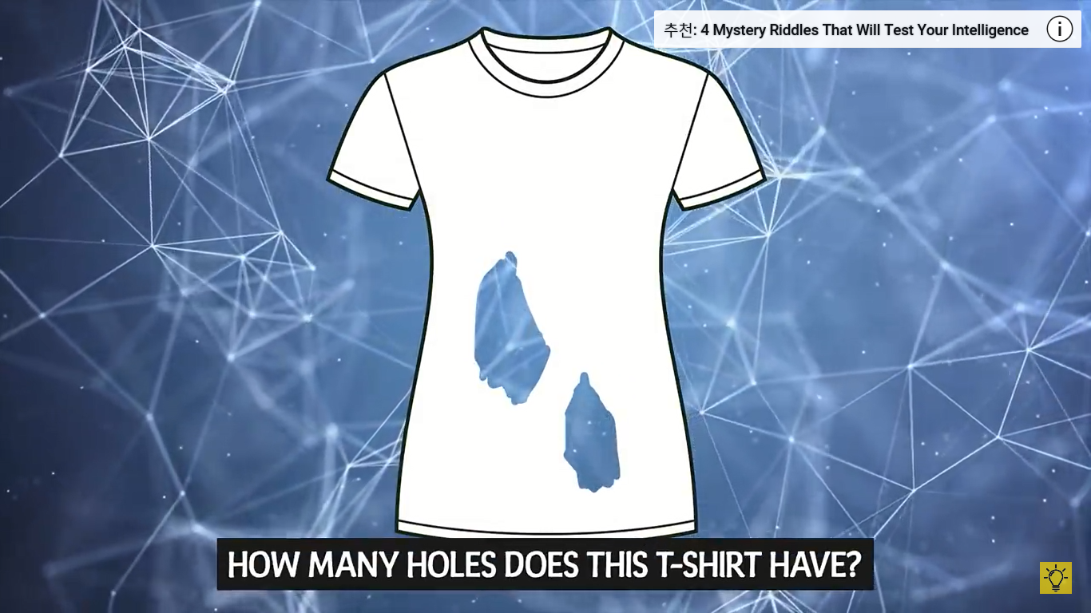
.

Slide 4
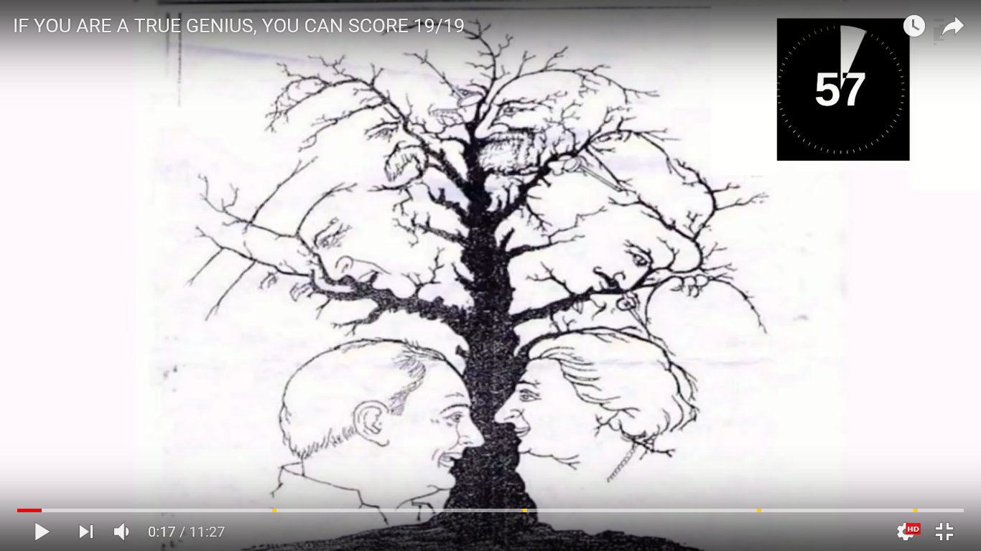

Slide 5
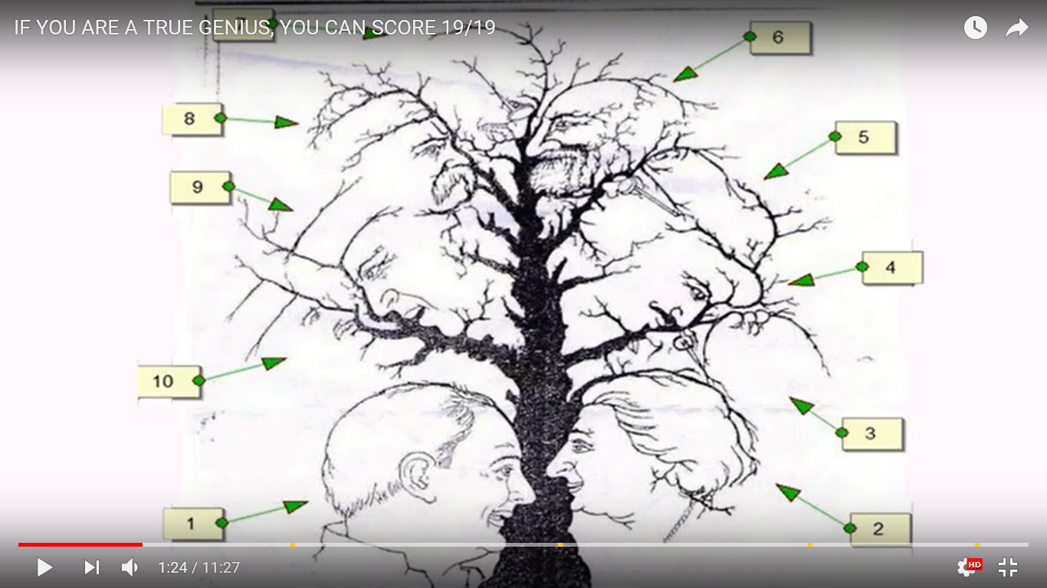

Slide 6
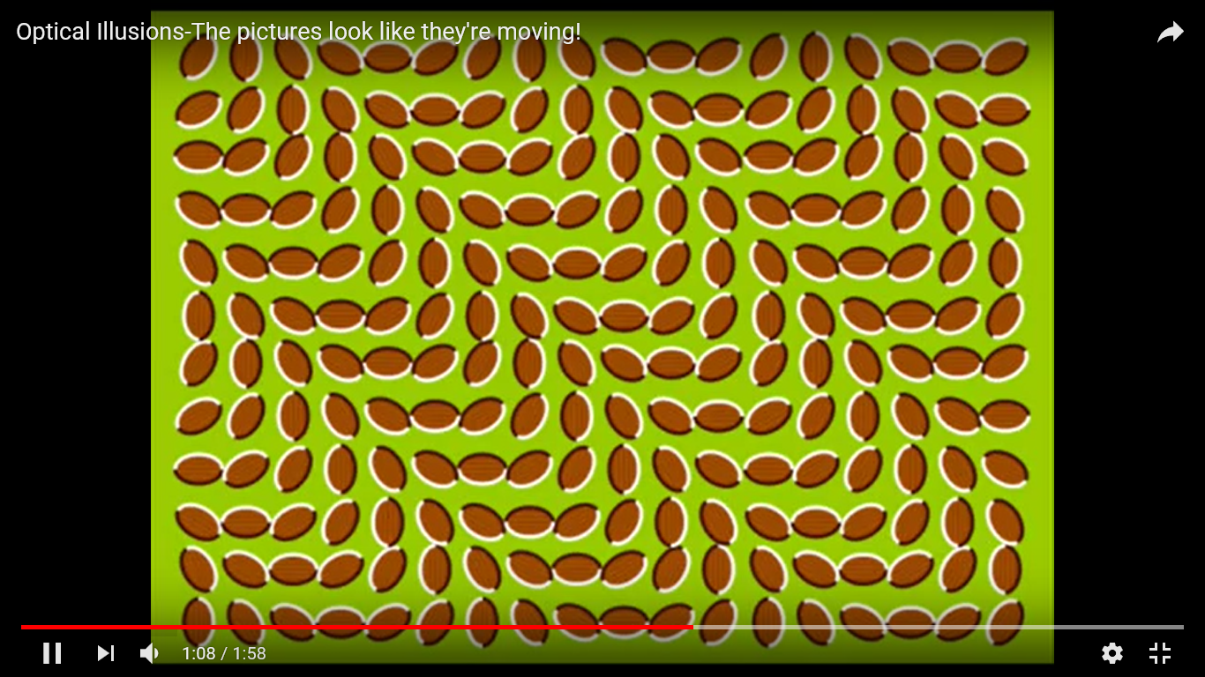

Slide 7
12 ILLUSIONS TO TEST YOUR BRAIN see two images in 15s, you are a genius.
https://www.youtube.com/watch?v=5yozF0VnRBA

Slide 8
12 ILLUSIONS TO TEST YOUR BRAIN ♯2 |see two images in 15s, you are a genius
https://www.youtube.com/watch?v=7EgjiQjFRsU

Slide 9
Can You Find Odd Emoji Out ?
Find the difference to test your brain
https://www.youtube.com/watch?v=fg5C854-ZJ0

Slide 10
Can You Find Hidden Animals in These 14 Photos?
https://www.youtube.com/watch?v=mm47C7nmwqg

Slide 11
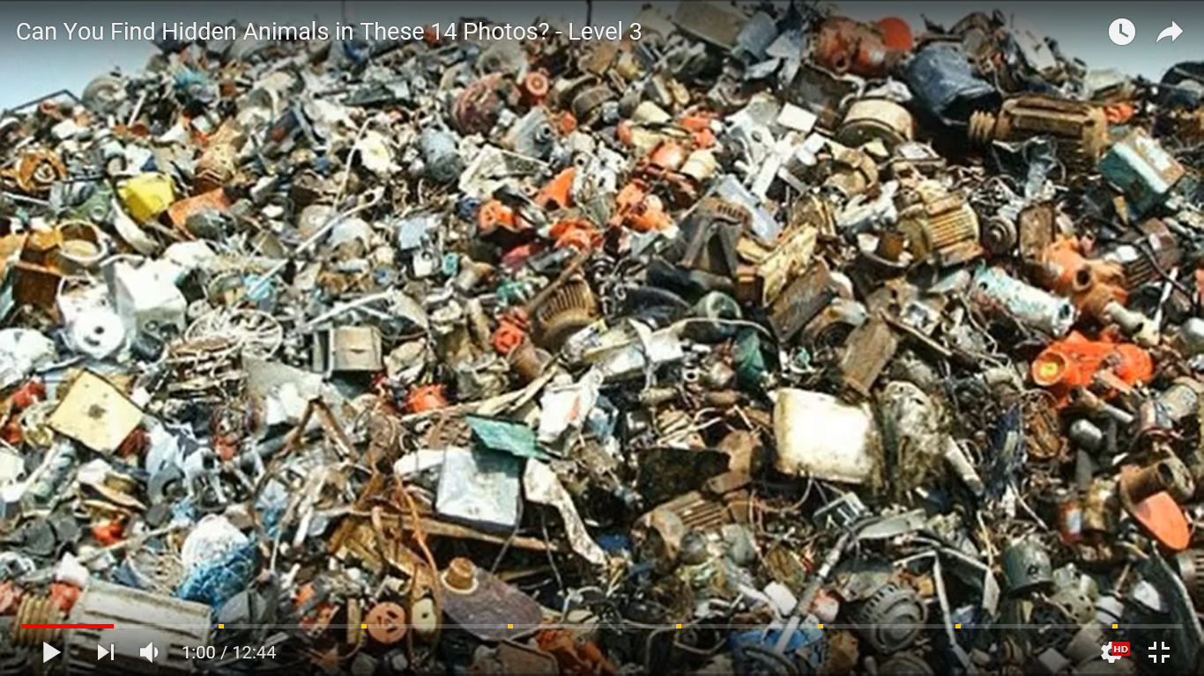

Slide 12
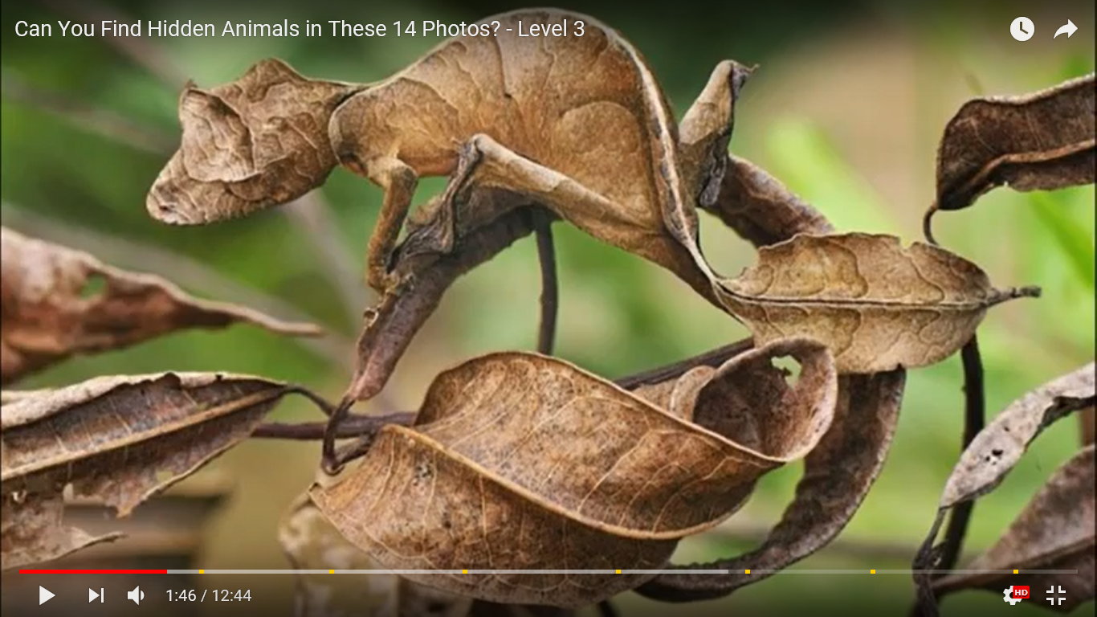

Slide 13
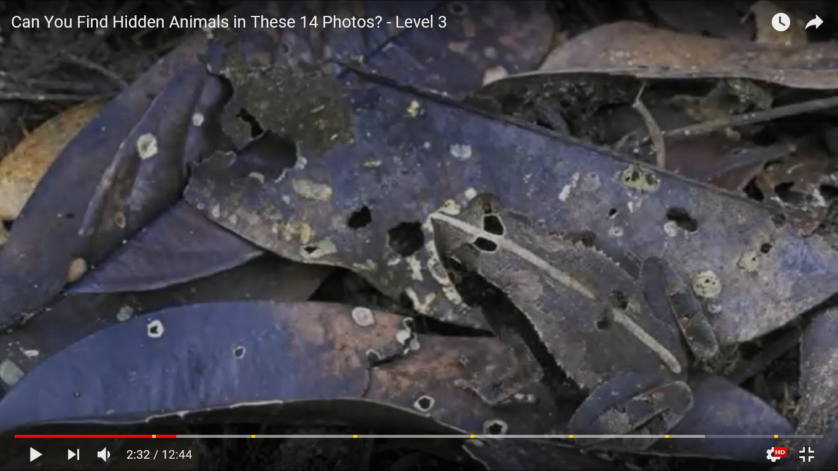

Slide 14
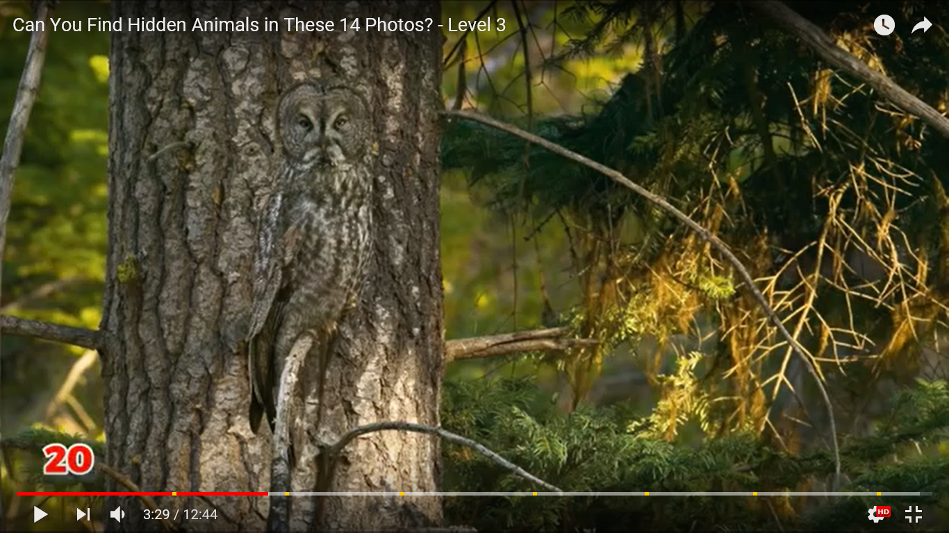

Slide 15
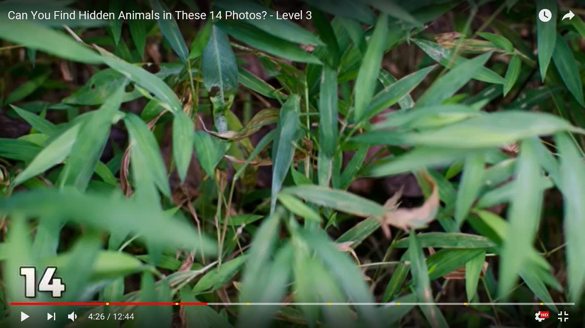

Slide 16
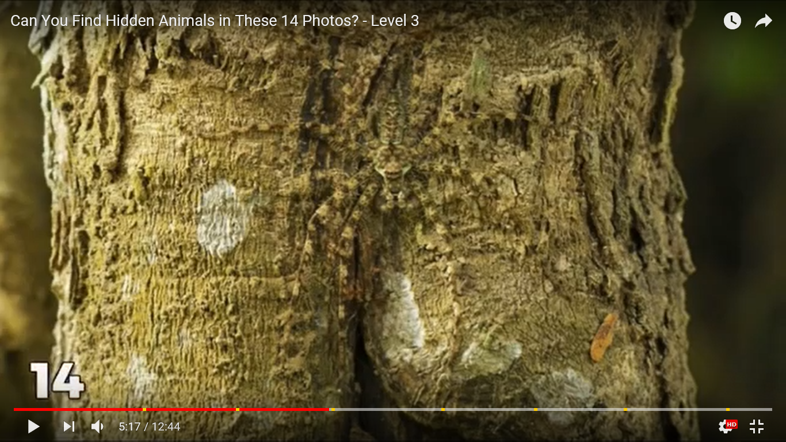

Slide 17
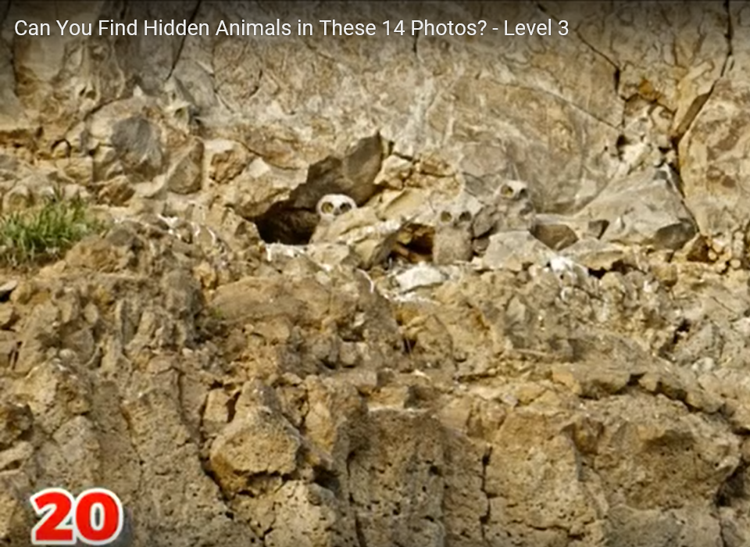

Slide 18
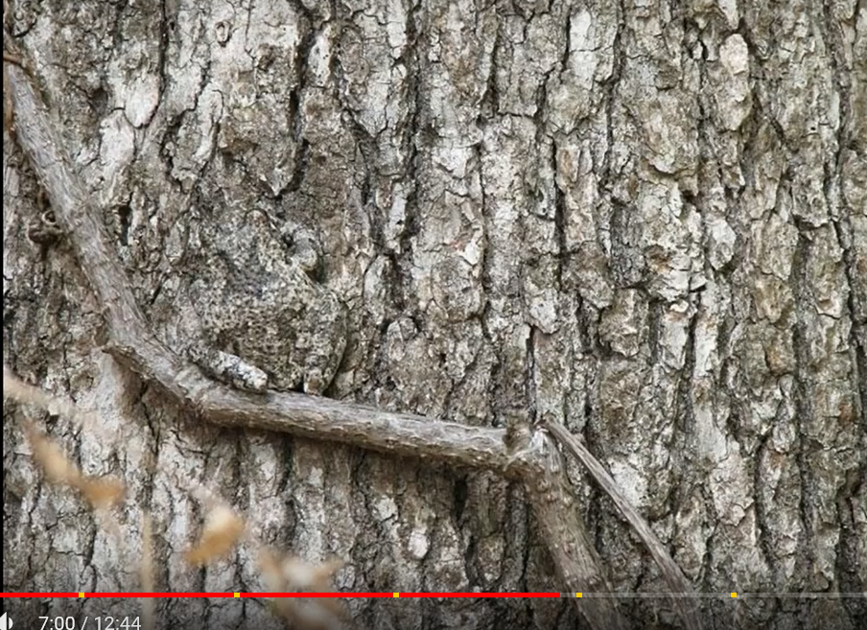

Slide 19
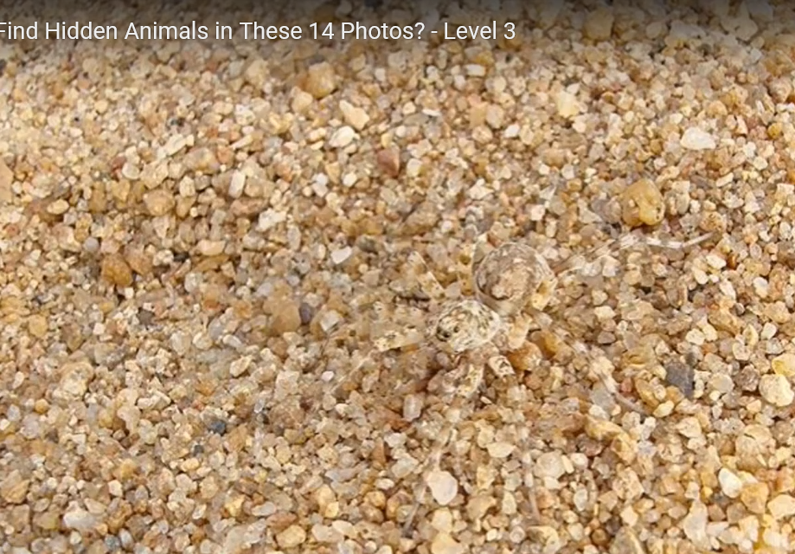

Slide 20
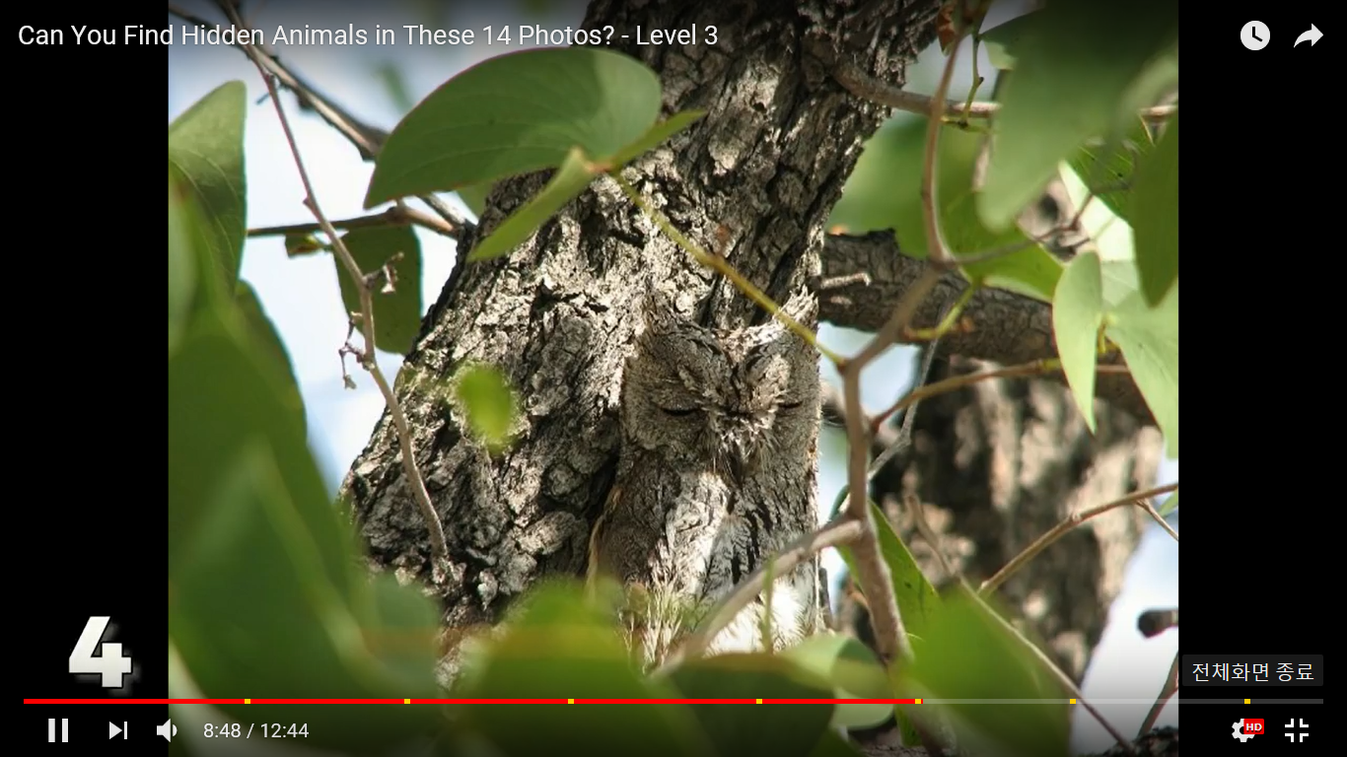

Slide 21
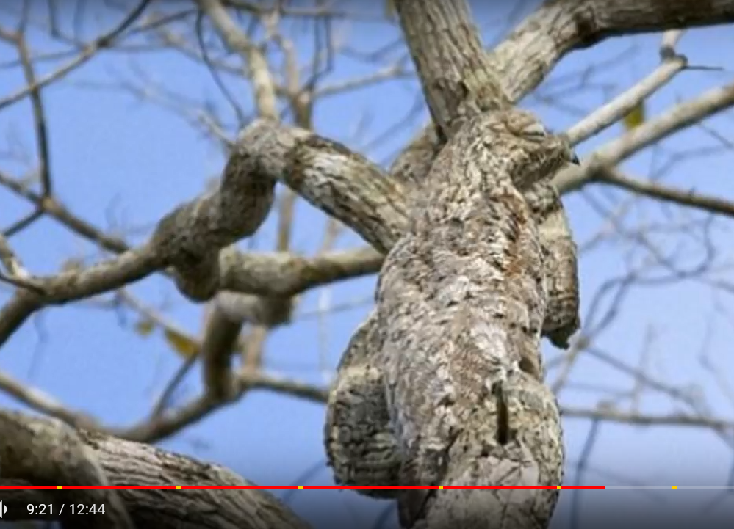

Slide 22
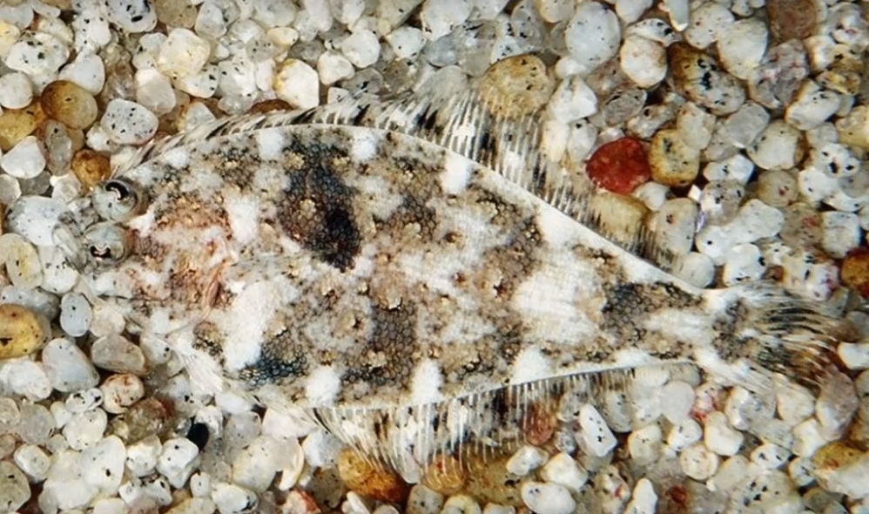

Slide 23
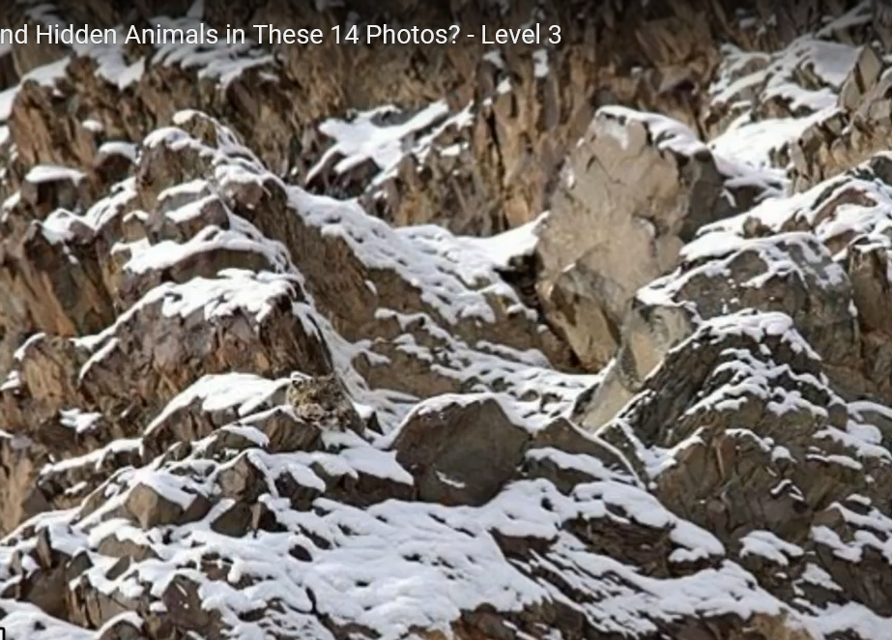

Slide 24
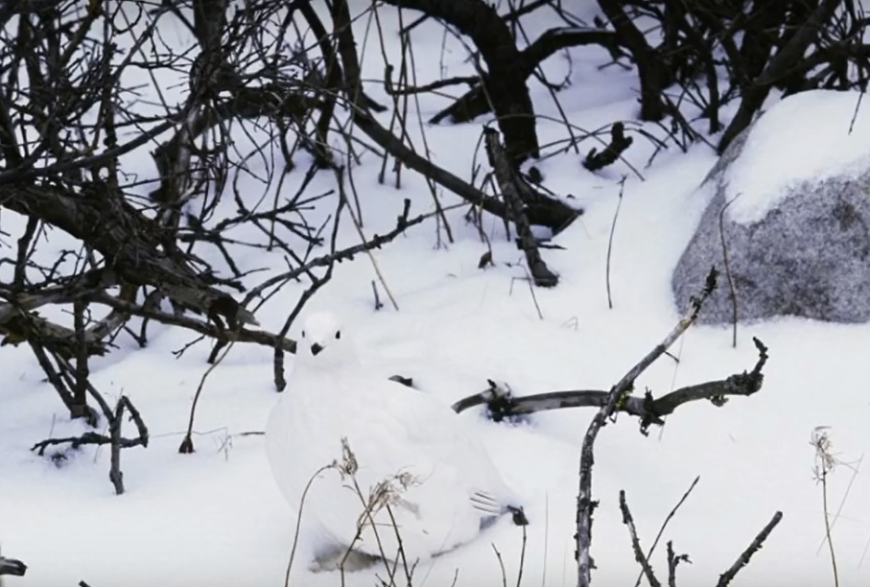

Slide 25
Only People With High IQ Can Find All The Differences
https://www.youtube.com/watch?v=Ka602KGoodo

Slide 26
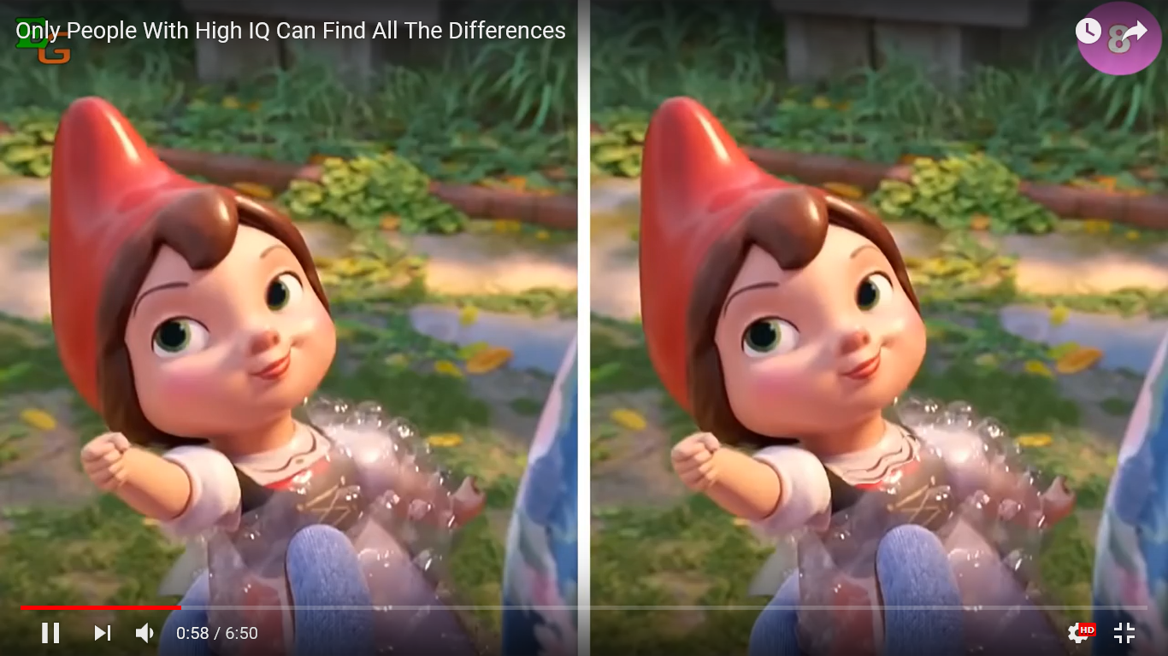

Slide 27
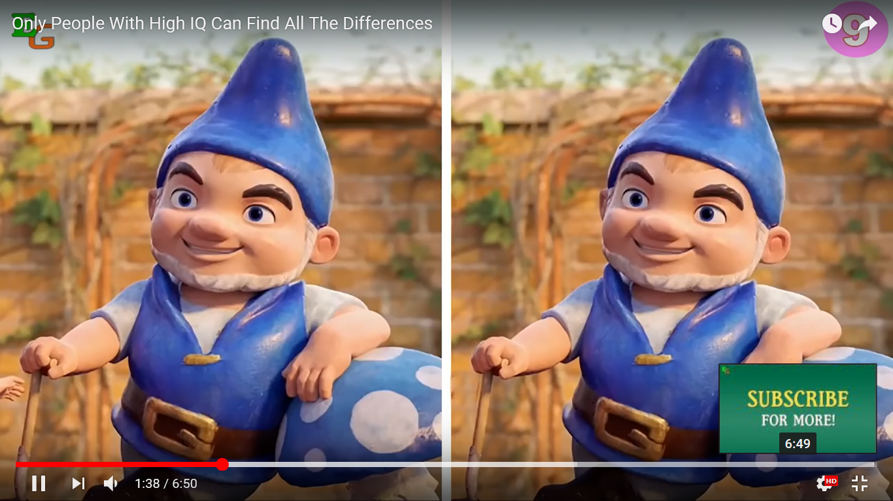

Slide 28
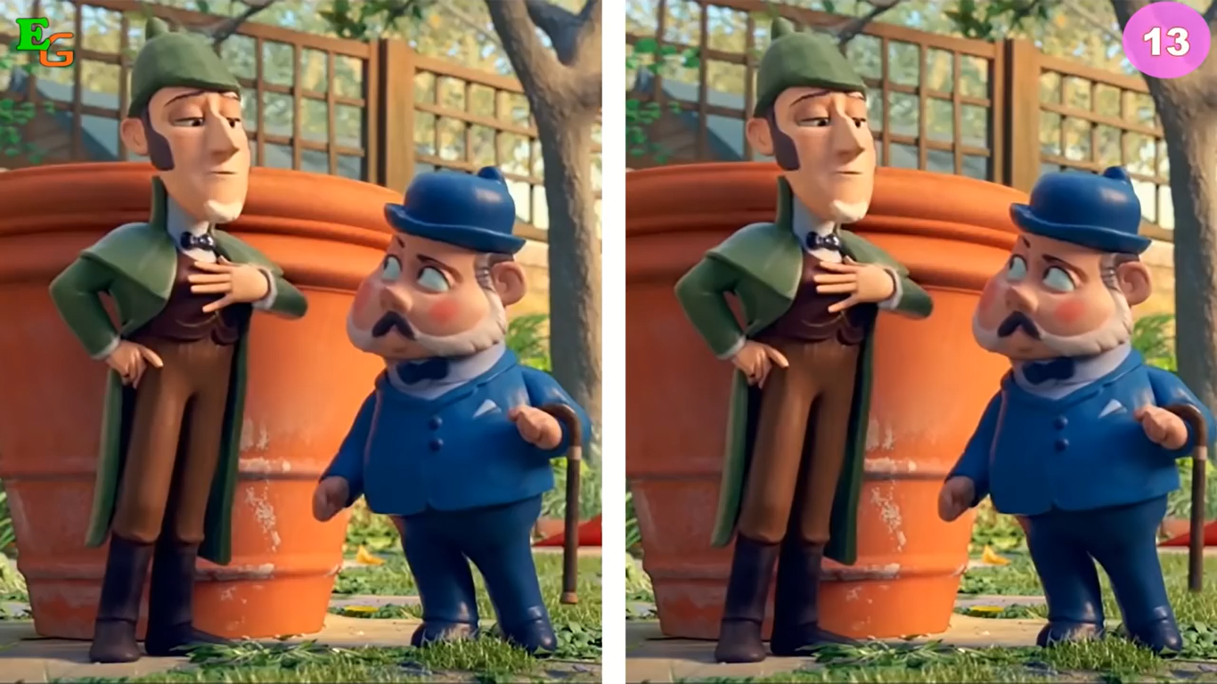

Slide 29
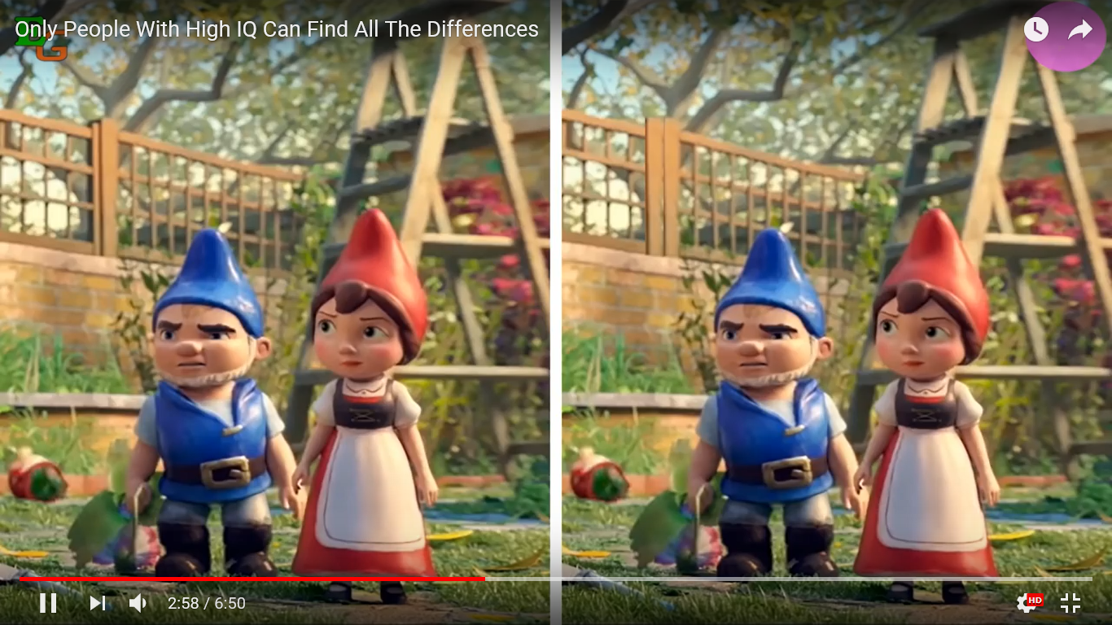

Slide 30
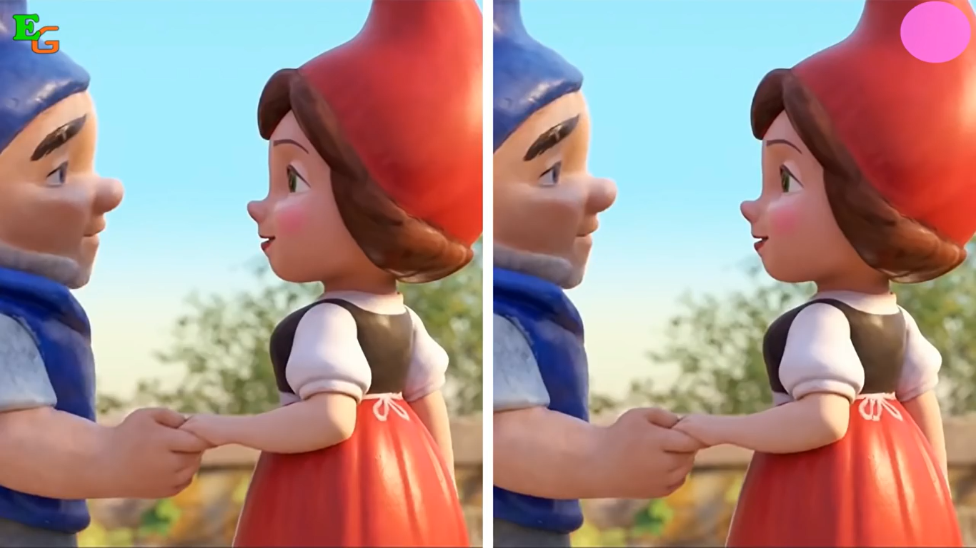

Slide 31
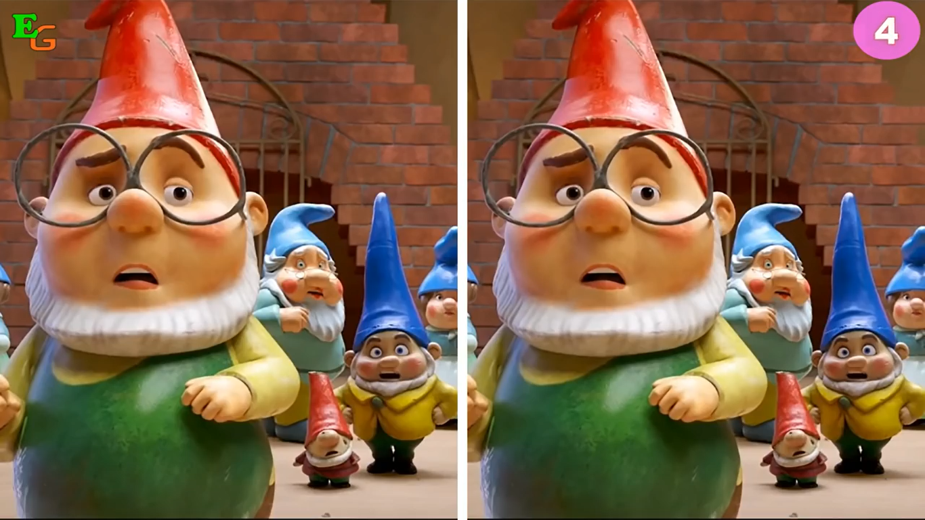

Slide 32
If you are a genuine,….
https://www.youtube.com/watch?v=SPSYZYO-AjU

Slide 35
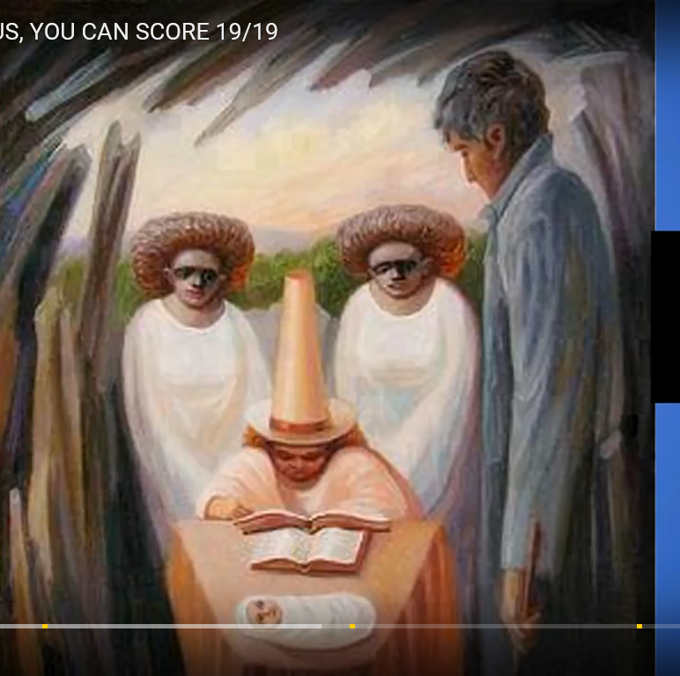

Slide 36
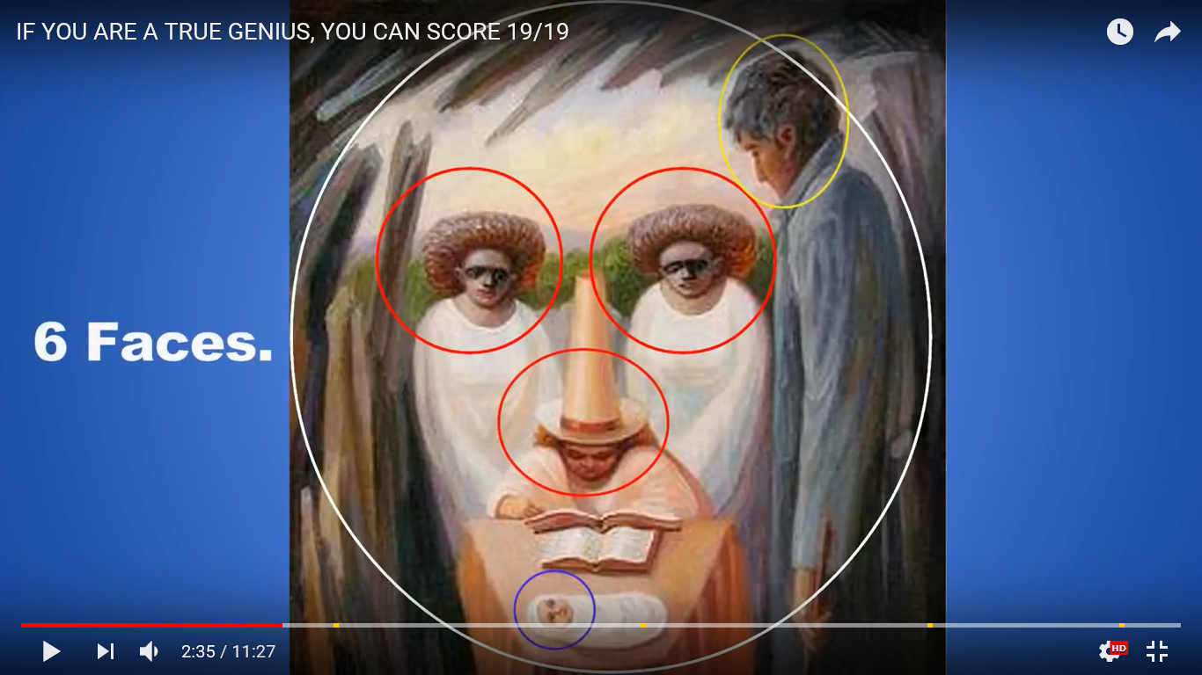

Slide 37
Britain’s Got Talent 2018
https://www.youtube.com/watch?v=Q3jege0p0dQ

